Slide 1

SRI SARADA NIKETEN COLLEGE FOR W0MEN.
AMARAVATHIPUDUR.

Slide 2

URBANAURA INTERIORS.
[TEAM11]
Team members:
S.Sangavi,
K.Priyanka,
KR.Sankavi,
V.Ramya.

Slide 3

INTRODUCTION
overview
Purpose
PROBLEM DEFINITION &DESIGN THINKIng
Empathy map
Brainstorming map
RESULTS
ADVANTAGES AND DISADVANTAGES
APPLICATIONS
CONCLUSIONS
FUTURE SCOPE

Slide 4

INTRODUCTION...
Zoho Books is an accounting solution that is designed to help small businesses manage their finances.
This solution includes dashboards and a wide variety of reports. Business users can automate tasks and set up custom workflows.
Zoho Books is a smart accounting system designed for growing businesses. It is very simple, easy to use, and able to help you make intelligent data-based decisions.

Slide 5


overview:
Zoho Books is designed to help your business connect across multiple platforms.
Extend your accounting with a library of more than 300 business apps via Zapier, or take advantage of built-in connections with other apps in the Zoho suite.

Slide 6

PURPOSE...
Zoho CRM acts as a single repository to bring your sales, marketing, and customer support activities together, and streamline your process, policy, and people in one platform. It looks like you're in the united states based on your IP.

Slide 7
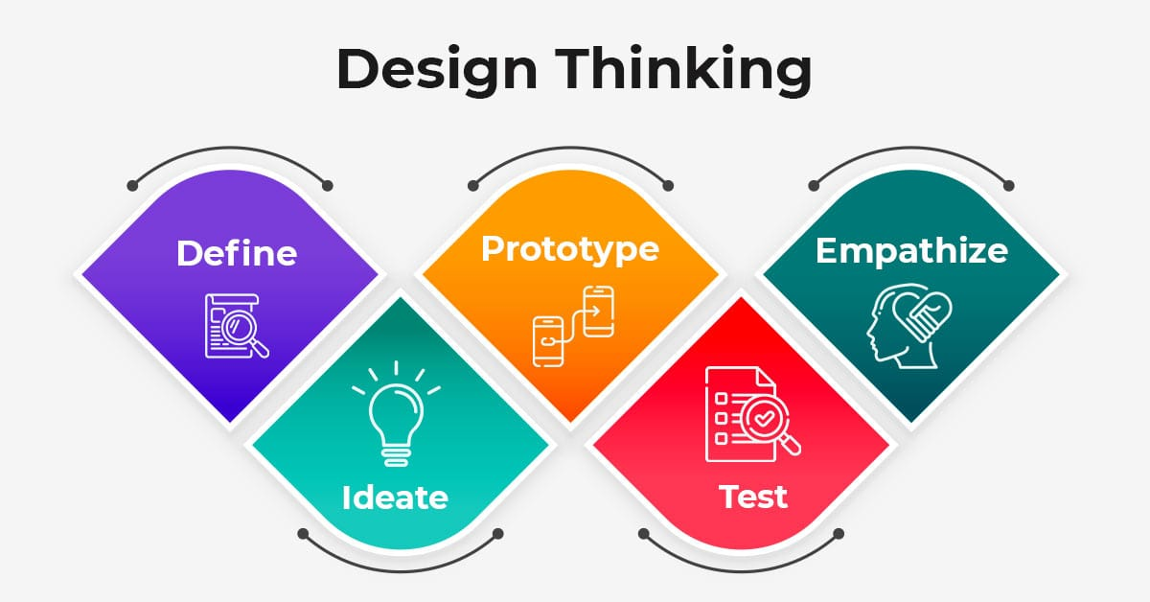
PROBLEM DEFINITION & DESIGN THINKING
Zoho Books is an online accounting application that takes care of the accounting needs of your business. You can record, audit and analyze all financial transactions easily.

Slide 8

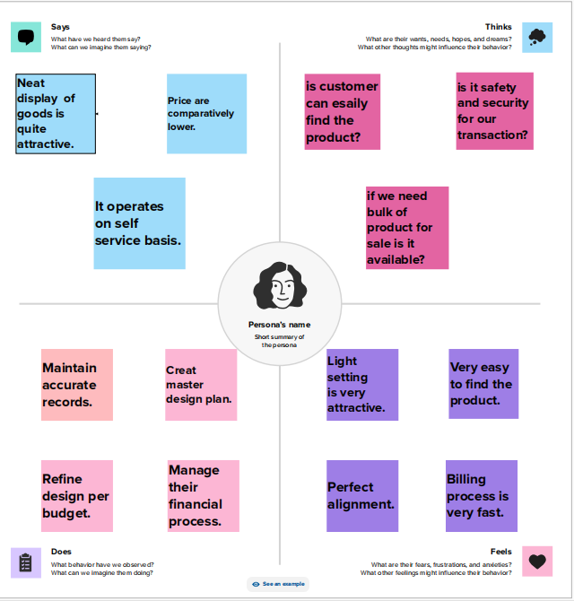
EMPATHY MAP:

Slide 9
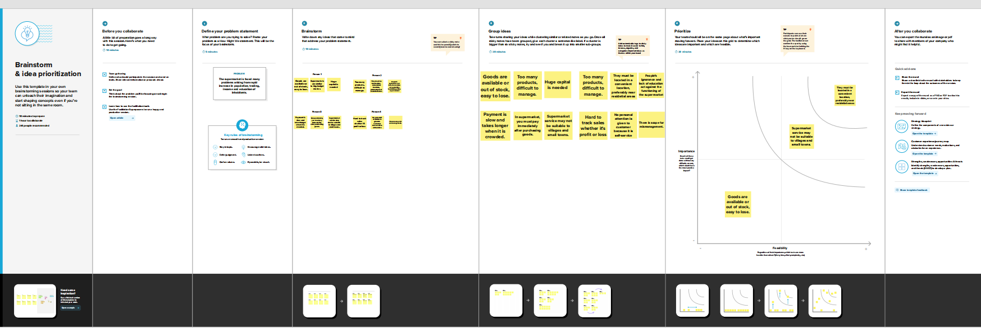
BRAINSTORMING MAP:

Slide 10
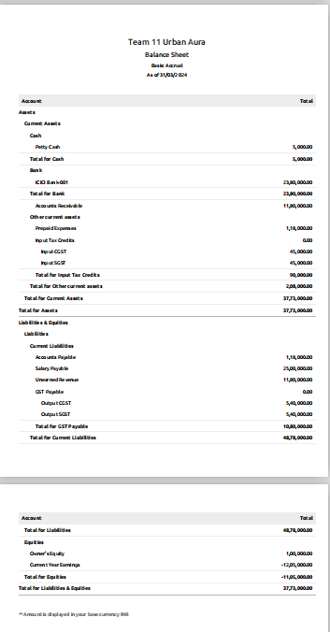
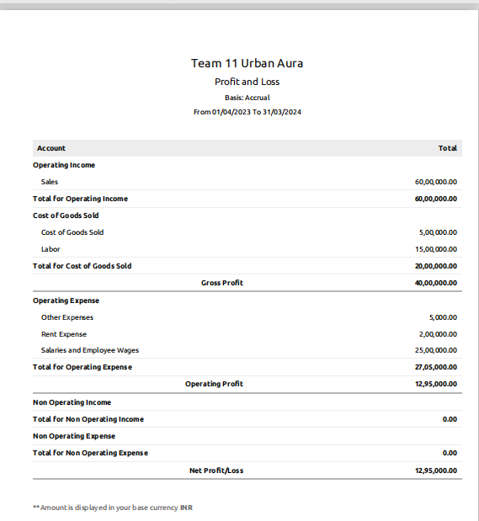
RESULTS;
Pofit & Loss A/C
Balance Sheet

Slide 11
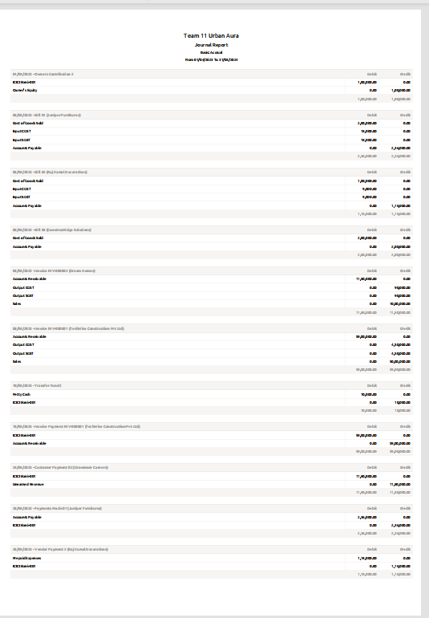
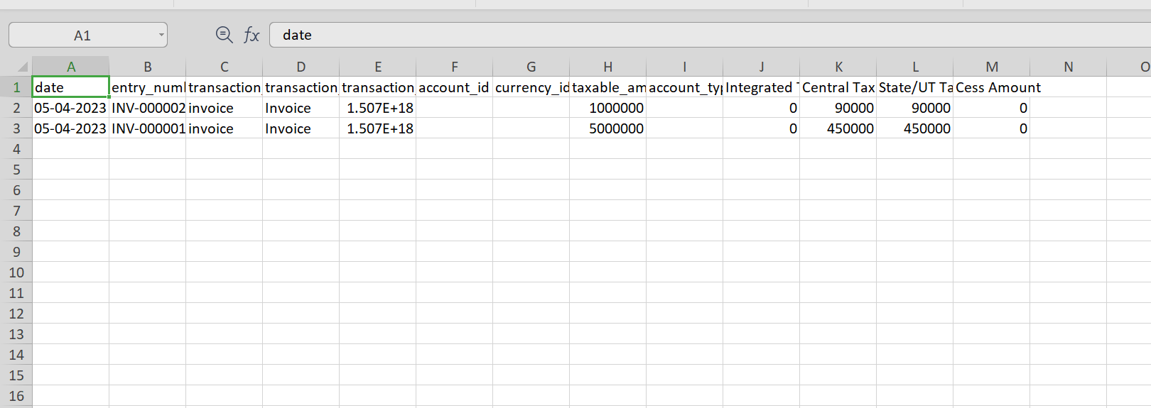
Journal Report

Slide 12
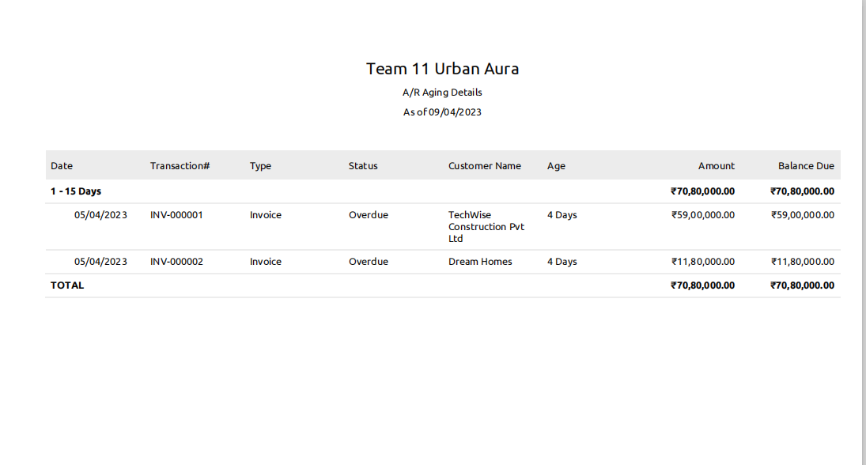
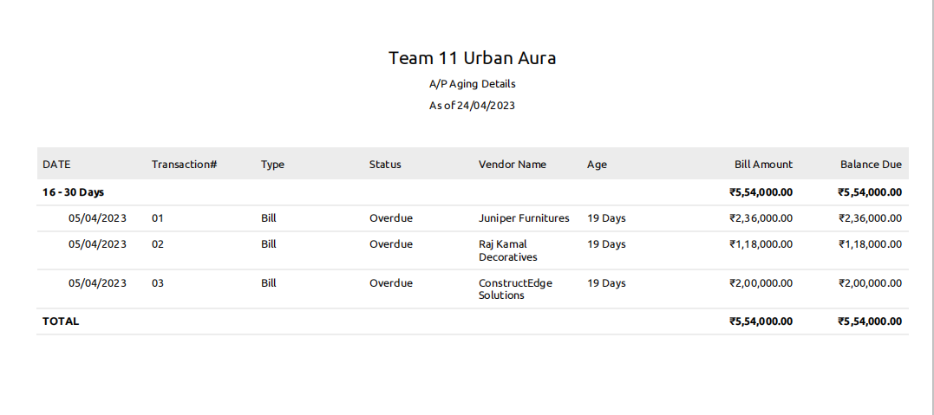

Slide 13
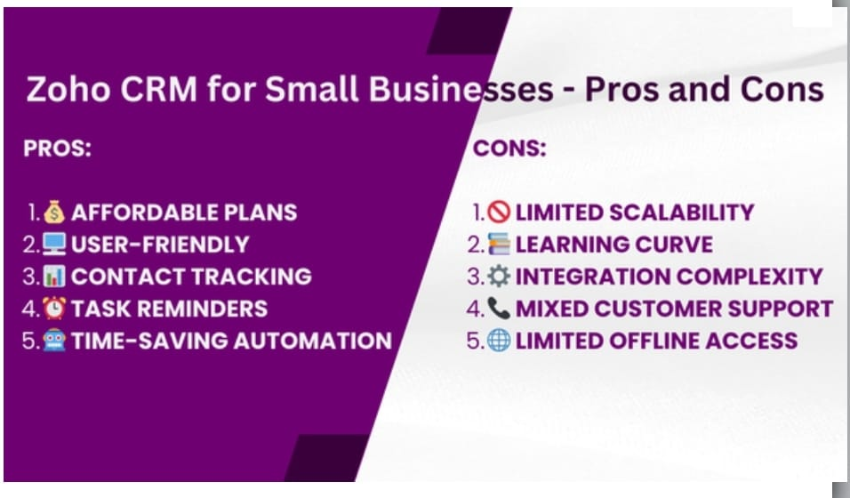

Slide 14
APPLICATION
Zoho Books is a modern accounting app designed for Windows 10.
Send Quotes and invoices, record expenses and bills, manage projects, and streamline your accounting.

Slide 15

CONCLUSION:
Zoho Books is easy to understand and its configuration is quick and easy.
The automation of the system is great and you save a lot of time.

Slide 16
FUTURE SCOPE:
Zoho development is going to focus on cloud services. Furthermore, expectations are that cloud would form 70% of Zoho's business and 30% would be from on-premise offerings. However, Zoho is going to continue its global expansion plans.

